Slide 1

DETECTION OF ATTACKS USING RFA
Project Supervisor: Dr. E. Murali., B.E., M.Tech., Ph.D
Team Member :1. RAMANA CHANDRAKIRAN REDDY
Reg.No : 39110835
2. RAMAKURTHI PRAVEEN KUMAR
Reg.No : 39110834

Slide 2
PRESENTATION OUTLINE
Introduction
Abstract
Objectives
Existing System
Problem Statement
Proposed System
Literature survey
Flow Diagram
System Architecture
Module Implementation
References

Slide 3
INTRODUCTION
Approaches for intrusion detection can be broadly divided into two types: misuse detection and anomaly detection. In misuse detection system, all known types of attacks (intrusions) can be detected by looking into the predefined intrusion patterns in system audit traffic.
In case of anomaly detection, the system first learns a normal activity profile and then flags all system events that do not match with the already established profile.
The main advantage of the misuse detection is its capability for high detection rate with a difficulty in finding the new or unforeseen attacks.
The advantage of anomaly detection lies in the ability to identify the novel (or unforeseen) attacks at the expense of high false positive rate

Slide 4
ABSTRACT
Intrusion detection systems (IDSs) are currently drawing a great amount of interest as a key part of system defence. IDSs collect network traffic information from some point on the network or computer system and then use this information to secure the network.
An analyst must review all the data that large and wide to find the sequence of intrusion on the network connection. Therefore, it needs a way that can detect network intrusion to reflect the current network traffics.
In this study, a novel method to find intrusion characteristic for IDS using genetic algorithm machine learning of data mining technique was proposed. Method used to generate of rules is classification by genetic algorithm of decision tree.
These rules can determine of intrusion characteristics then to implement in the genetic algorithm as prevention.
so that besides detecting the existence of intrusion also can execute by doing deny of intrusion as prevention.

Slide 5
OBJECTIVE
The primary purposes for an IDS deployment are to reduce risk, identify error, optimize network use, provide insight into threat levels, and change user behavior. Thus, an IDS provides more than just detection of intrusion.
Genetic Algorithm (GA) developed specifically for problems with multiple objectives. They differ primarily from traditional GA by using specialized fitness functions and introducing methods to promote solution diversity.
The goal of this algorithm is to create a model that predicts the value of a target variable, for which the decision tree uses the tree representation to solve the problem in which the leaf node corresponds to a class label and attributes are represented on the internal node of the tree

Slide 6
EXISTING SYSTEM
Today network has become an essential part of public infrastructures with the inception of public and private cloud computing.
The traditional networking approach has become too complex.
This complexity has resulted in a barrier for creating new and innovative services within a single data center, difficulties in interconnecting data centers, interconnection within enterprises, and bigger barrier in the continued growth of the Internet in general.

Slide 7
PROBLEM STATEMENT
To distinguish the activities of the network traffic that the intrusion and normal is very difficult and to need much time consuming.
An analyst must review all the data that large and wide to find the sequence of intrusion on the network connection.
it needs a way that can detect network intrusion to reflect the current network traffics.
Combination of IDS and firewall so-called the IPS, so that besides detecting the existence of intrusion also can execute by doing deny of intrusion as prevention.

Slide 8
PROPOSED SYSTEM
Genetic algorithm is one of the most commonly used machine learning approach in the field of intrusion detection, which consists of its natural selection.
Decision node represents to testing a single attribute of the given instances whereas the leaf node presents the idea about whether the output of a classifier falls in to either normal or intrusion (any of the possible attacks) category during the classification phase.
a novel method to find intrusion characteristic for IDS using decision tree machine learning of data mining technique was proposed.
Method used to generate of rules is classification by genetic algorithm of decision tree

Slide 9
ADVANTAGES
Intrusion detection can be performed manually or automatically
IDS need to be able to deal with a large and ever-increasing flow of alerts and events.
Using Decision trees is more essential.
automatic procedures for detecting and responding to intrusion are becoming increasingly essential

Slide 10
LITERATURE REVIEW
s.no | AUTHOR | DISCRIPTION | ADVANTAGE | DISADVANTAGE
1 | Ahmed, Naser Mahmood, Hu 2016; Agrawal, Soni, Agrawal 2017 | An attack is a security threat that involves, but is not limited to, attempting to steal, obtaining and altering information without authorized access or gaining access to a network without permission. | Denial of Service (DoS), User to Root (U2R), Remote to User (R2L) | these categories of attacks are described.
2 | (Dias, Cerqueira, Assis, Almeida 2017. | Denial of Service is a type of attack whereby the attacker aims to prevent the authorized user from using the computer services. | DoS can be done by flooding the network and disrupting a connection or service. | DoS attacks include Smurf, Land and Ping of Death
3 | (Dias, Cerqueira, Assis, Almeida 2017). | he user to root attack is a type of attack whereby the attacker gets access to a normal user account | then exploits system vulnerabilities to gain root privileges | U2R attacks are Load module, Rootkit and Buffer overflow

Slide 11
Con……….
 | Author | description | advantage | disadvantage
4 | Zhao | presented a state-of-the-art survey of deep learning applications within machine hake monitoring | the DDoS detection system proposed | Less efficiency method used in this system
5 | L. You, Y. Li, Y. Wang, J. Zhang, and Y. Yang, | propose an automatic security auditing tool for short messages (SMS). | Their method is based upon the RNN model | evaluations resulted in an accuracy rate of 50.7%
6 | Y. Wang, W.-d. Cai, and P.-c. Wei, | propose an approach for detecting malicious JavaScript | Their method uses a 3 layer SdA with linear regression. | was evaluated against other classifier techniques, showing that it had the low result.

Slide 12
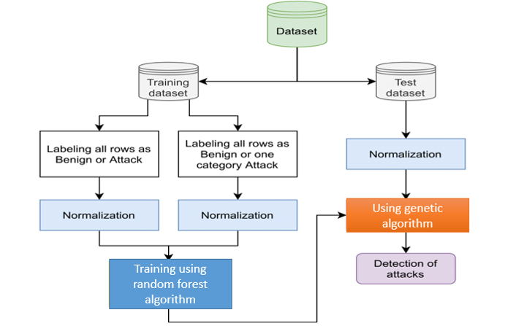
FLOW DIAGRAM

Slide 13
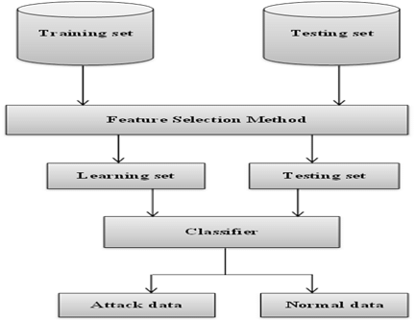
SYSTEM ARCHITECTURE

Slide 14
MODULES IMPLEMENTATION
Dataset collection
Data Cleaning
Feature Extraction
Model training
Testing model
Performance Evaluation
Prediction

Slide 15
MODEL TRAINING
A training model is a dataset that is used to train an ML algorithm. It consists of the sample output data and the corresponding sets of input data that have an influence on the output.
The training model is used to run the input data through the algorithm to correlate the processed output against the sample output. The result from this correlation is used to modify the model.
This iterative process is called “model fitting”. The accuracy of the training dataset or the validation dataset is critical for the precision of the model.
Model training in machine language is the process of feeding an ML algorithm with data to help identify and learn good values for all attributes involved.
There are several types of machine learning models, of which the most common ones are supervised and unsupervised learning.
In this module we use supervised classification algorithms like random forest to train the model on the cleaned dataset after dimensionality reduction.

Slide 16
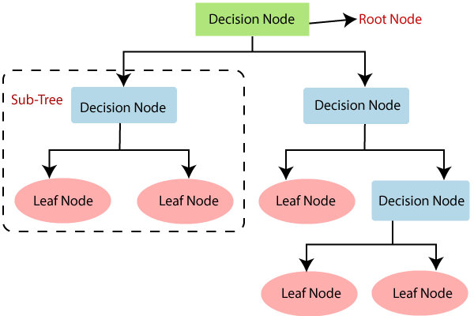

Slide 17
TESTING MODEL
In this module we test the trained machine learning model using the test dataset
Quality assurance is required to make sure that the software system works according to the requirements. Were all the features implemented as agreed? Does the program behave as expected? All the parameters that you test the program against should be stated in the technical specification document.
Moreover, software testing has the power to point out all the defects and flaws during development. You don’t want your clients to encounter bugs after the software is released and come to you waving their fists. Different kinds of testing allow us to catch bugs that are visible only during runtime.

Slide 18
PREDICTION
Prediction” refers to the output of an algorithm after it has been trained on a historical dataset and applied to new data when forecasting the likelihood of a particular outcome, such as whether or not a customer will churn in 30 days.
The algorithm will generate probable values for an unknown variable for each record in the new data, allowing the model builder to identify what that value will most likely be.
The word “prediction” can be misleading. In some cases, it really does mean that you are predicting a future outcome, such as when you’re using machine learning to determine the next best action in a marketing campaign.
Other times, though, the “prediction” has to do with, for example, whether or not a transaction that already occurred was fraudulent.
In that case, the transaction already happened, but you’re making an educated guess about whether or not it was legitimate, allowing you to take the appropriate action.
In this module we use trained and optimized machine learning model to predict whether the patient the divers case asking some questions .

Slide 19
GENETIC ALGORITHMS
Genetic algorithms are commonly used to generate high-quality solutions to optimization and search problems by relying on biologically inspired operators such as mutation, crossover and selection.
Genetic algorithms are used in artificial intelligence like other search algorithms are used in artificial intelligence to search a space of potential solutions to find one which solves the problem
“Genetic Algorithms are good at taking large, potentially huge search spaces and navigating them, looking for optimal combinations of things, solutions you might not otherwise find in a lifetime.”

Slide 20
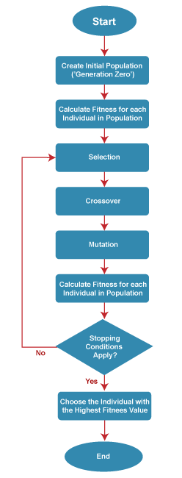
GENETIC ALGORITHM WORKFLOW

Slide 21

APPLICATION SCREENSHOTS

Slide 22
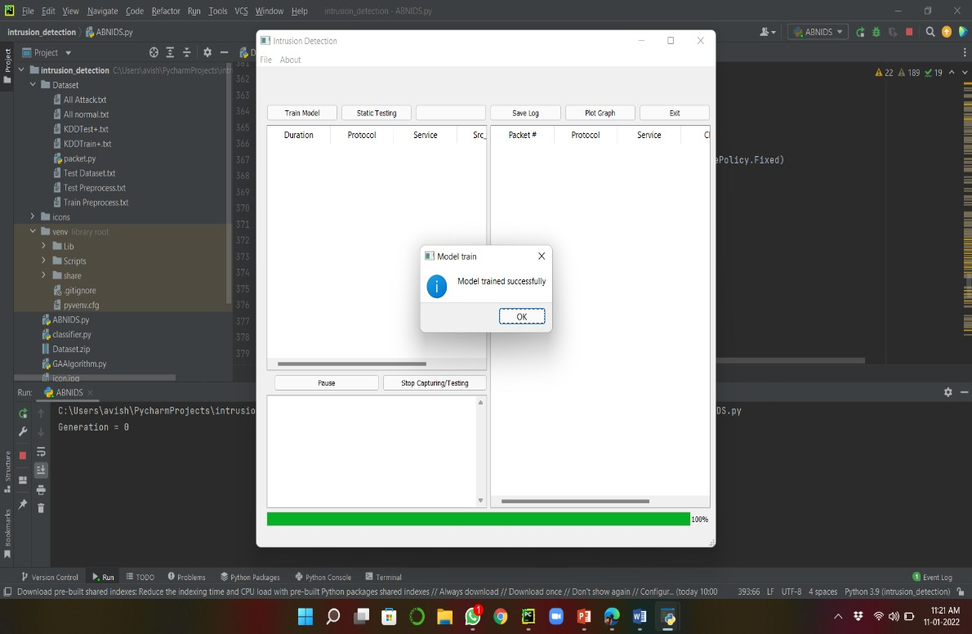

Slide 23
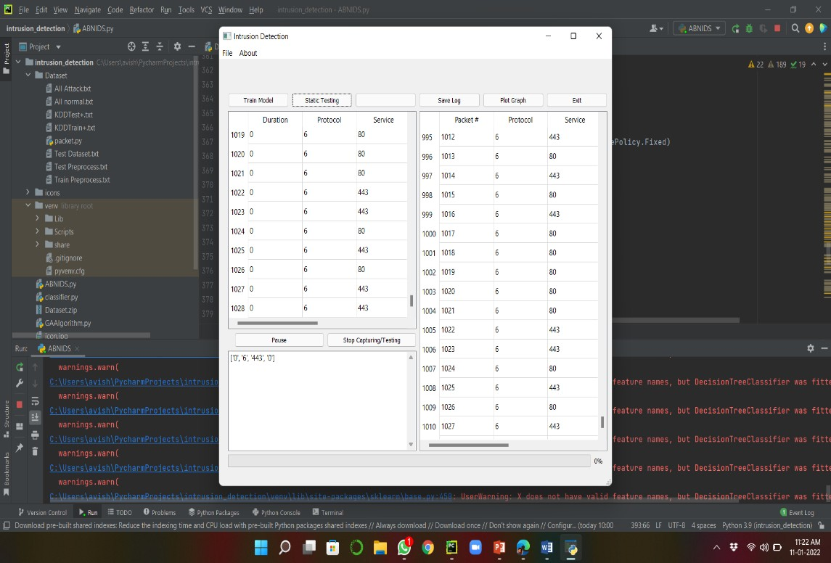

Slide 24
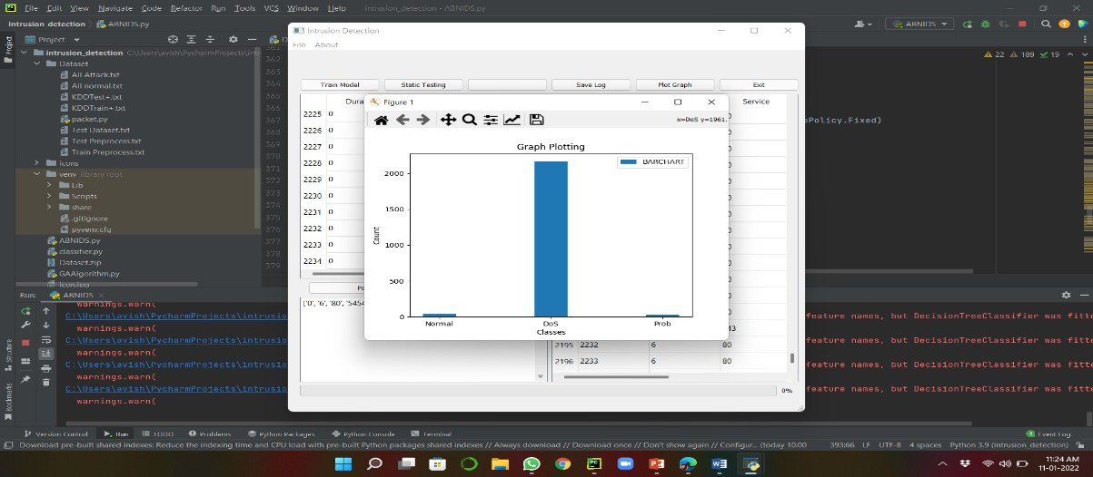

Slide 25
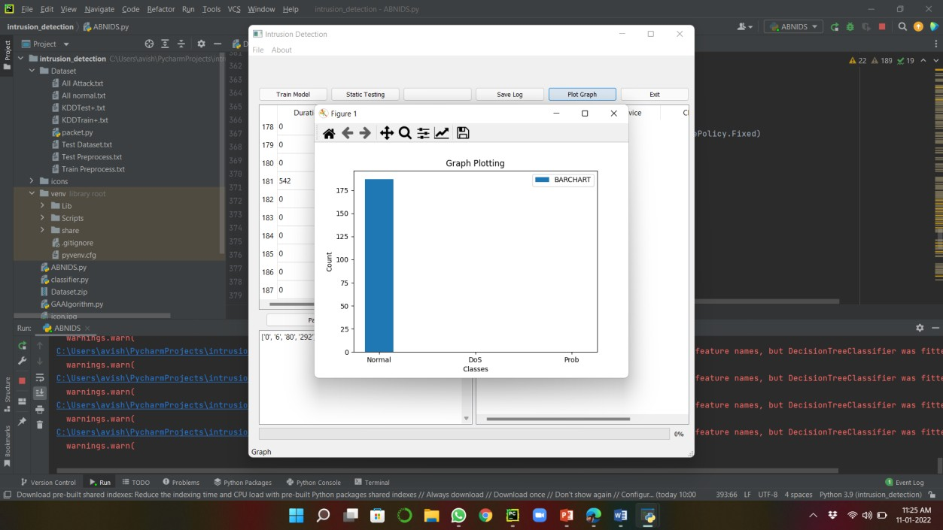

Slide 26
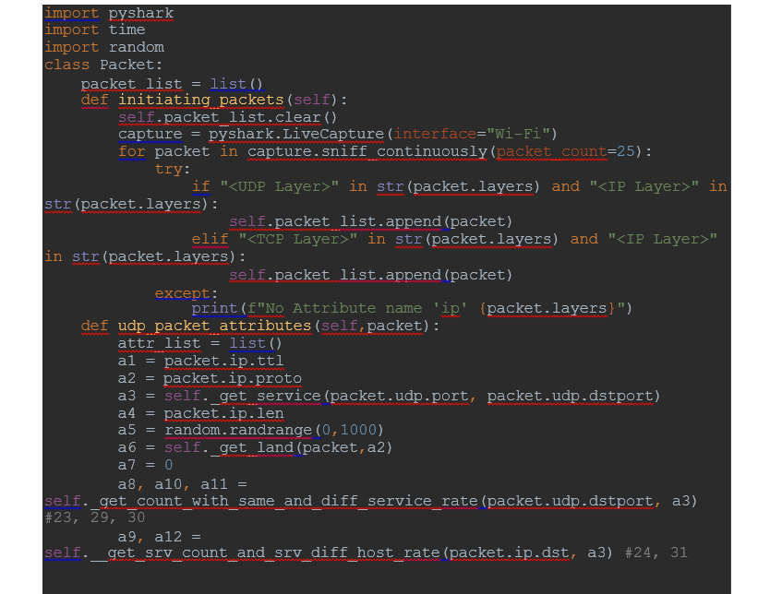
CODE

Slide 27
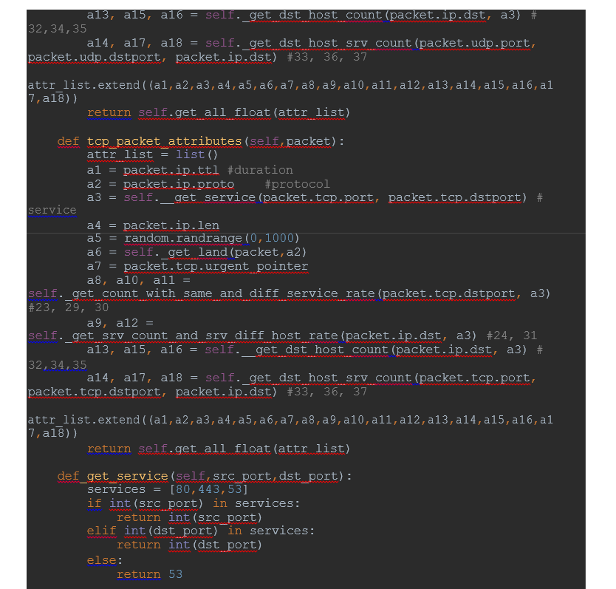

Slide 28
CONCLUSION
Network traffic logs to describe patterns of behavior in network traffic accident with intrusive or normal activity.
Decision tree technique is good for the intrusion characteristic of the network traffic logs for security attack and implemented in the genetic algorithm as prevention.
The other hand, this technique is also good efficiency and optimize rule for the security attack rules such as avoid redundancy.

Slide 29
REFERENCES
[1] R. M. A. Ujjan, Z. Pervez, K. Dahal, A. K. Bashir, R. Mumtaz, and J. González, "Towards sFlow and adaptive polling sampling for deep learning based DDoS detection in SDN," Future Generation Computer Systems, vol. 111, pp. 763-779, 2020, doi: 10.1016/j.future.2019.10.015.
[2] "Software Defined Networking Definition." https://www.opennetworking.org/sdn-definition/ (accessed March, 2, 2020).
[3] S. Garg, K. Kaur, N. Kumar, and J. J. P. C. Rodrigues, "Hybrid Deep-Learning-Based Anomaly Detection Scheme for Suspicious Flow Detection in SDN: A Social Multimedia Perspective," IEEE Transactions on Multimedia, vol. 21, no. 3, pp. 566-578, 2019, doi: 10.1109/tmm.2019.2893549.
[4] M. Nobakht, V. Sivaraman, and R. Boreli, "A Host-Based Intrusion Detection and Mitigation Framework for Smart Home IoT Using OpenFlow," presented at the 2016 11th International Conference on Availability, Reliability and Security (ARES), 2016.
[5] M. S. Elsayed, N. Le-Khac, S. Dev, and A. D. Jurcut, "Machine Learning Techniques for Detecting Attacks in SDN," in 2019 IEEE 7th International Conference on Computer Science and Network Technology (ICCSNT), 19-20 Oct. 2019 2019, pp. 277-281, doi: 10.1109/ICCSNT47585.2019.8962519.

Slide 30
THANK YOU

